Slide 1
Healthy food
Составил:
учитель английского языка Похвалитова Е.В.

Slide 2
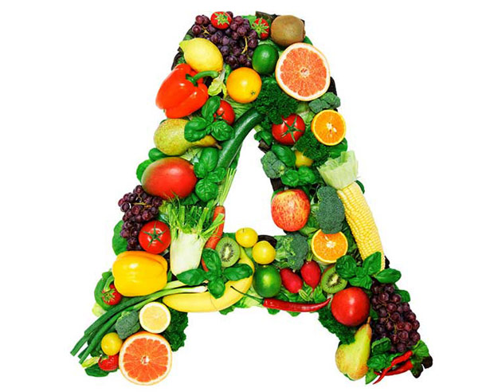
Vitamin A
Vitamin A is one of several major vitamins for our health. Vitamin A is important for eyes. Vitamin A keeps skin healthy and prevents skin from drying out.
Vitamin A is in carrots, tomatoes, liver, milk, cheese, pumpkin, broccoli, peas, asparagus, green pepper, eggs and apples.

Slide 3
Vitamin B1
Vitamin B1 is necessary for the heart, muscles, and nervous system.
Vitamin B1 is in meat, fish, dried beans, peas and bread.

Slide 4
Vitamin B6
Vitamin B6 is important for normal brain and nerve function. A wide variety of food contains vitamin B6, including potatoes, bananas, beans, nuts, red meat, fish, eggs, spinach, and cereals.

Slide 5
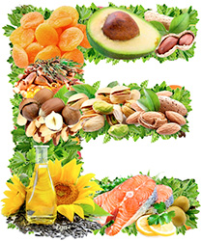
Vitamin E
Vitamin E helps to protect cells from damage. It is necessary for skin and body. Vitamin E is in many foods, such as vegetable oils, nuts, corn, wheat, avocados, olives and green vegetables.

Slide 6
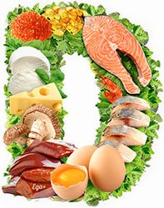
Vitamin D
Vitamin D is for bones. This vitamin is unique — your body can get it when you get sunlight on your skin! You can also get vitamin D from eggs, cheese, butter, milk and fish oils.

Slide 7
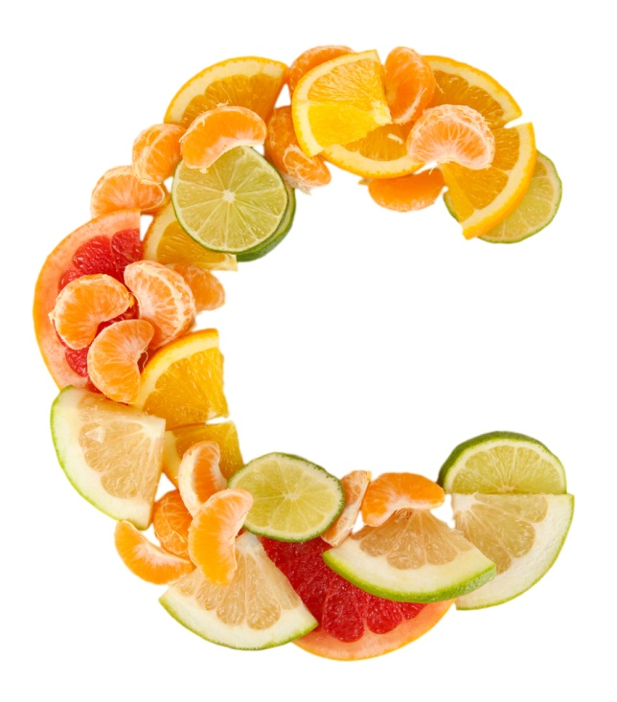
Vitamin C
Vitamin C is important for healthy bones, teeth. It helps to prevent colds. Citrus fruits, green peppers, tomatoes, strawberries, broccoli, sweet and white potatoes, black currants are all excellent food sources of vitamin C.

Slide 8
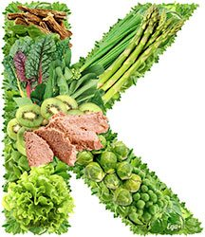
Vitamin K
Vitamin K is necessary for human blood. You can find vitamin K in broccoli, parsley, cabbage.

